Slide 1

ISOM-631 Team Project
By Team D: Ameesha Bhasin, Aneri Rajesh Shah & Jue Tan
Topic – TAM Performance Tool
The aggregation component of the tool presents both TAM summary statistics (condition and performance) and aggregated information on asset inventories based on filter selections such as reporter type and TAM tier, as reported to FTA's National Transit Database (NTD).
https://www.transit.dot.gov/ntd/data- product/2021-tam-performance-tool

Slide 2
Variables | Definition of the Variables | Qualitative or Quantitative
Service Area Pop | A measure of transit service in terms of population served. | Quantitative
Type | Type of service | Qualitative- bus, minivan, cutaway, van, automobile, ferryboat, light rail vehicle etc.
Total units 2020 | Total units of a particular asset | Quantitative
Units Under Performance Threshold (2020) | The total units of a particular asset that has either met or exceeded its useful life benchmark | Quantitative
Total units 2021 | Total units of a particular asset | Quantitative
Units Under Performance Threshold (2021) | The total units of a particular asset that has either met or exceeded its useful life benchmark | Quantitative
2020 Target (%) | The performance measure target set in the year 2019 for the year 2020. Percentage value describes the number of assets that are not in a state of good repair | Quantitative
2021 Target (%) | The performance measure target set in the year 2020 for the year 2021. Percentage value describes the number of assets that are not in a state of good repair. | Quantitative
Service Area Sq Miles | A measure of transit service in terms of area coverage (square miles). | Quantitative
TAM Tier | A tier representation of what type of agency an agency falls under according to Transit Assit Management guidelines. | Qualitative- Tier-I (Rail), Tier-I (Fixed Route Voms), TierII

Slide 3
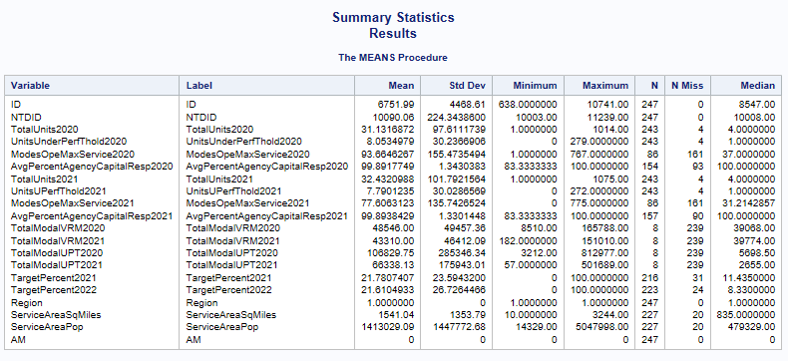
Summary Statistic of All Numeric Variables

Slide 4
Data Cleaning & Processing
Service Area population has 20 missing values so we will recode missing values with Median of service area population
Total Units and units under performance threshold have only 4 missing values each, we will exclude the rows of missing values.
Note – For Conversion of Tam_Tier column from Character to Numeric we will use dummy variables. Tier I = 1 , Tier II=2 for this a new column is created – TT_num
2021 Target % has 31 missing values so we will recode missing values with the median.

Slide 5
HYPOTHESIS1
Mode Comparison: Are certain transportation types consistently with service area population?
Hypothesis: Are the transportation types, like R (Rail and Related Transportation) or RV (Road Vehicles), have a higher proportion of service area population compared to other vehicles and Facilities.
H0 : there is no significant relationship between types, total units 2021, service area SqMiles with service area population.​
HA: there is a significant relationship between types, total units 2021, service area SqMiles with service area population.​
Regression equation:
P(Y) = b0 + b1*R + b2*RV + b3*TotalUnits2021 + b4*R_TotalUnits2021 + b5*R_ServiceAreaSqMiles + e
= 1606656+ 1342402*R - 1690966*RV + 1421.38*TotalUnits2021 – 894.14*R_TotalUnits2021 + 889.63*R_ServiceAreaSqMiles + e
Y = ServiceAreaPop

Slide 6
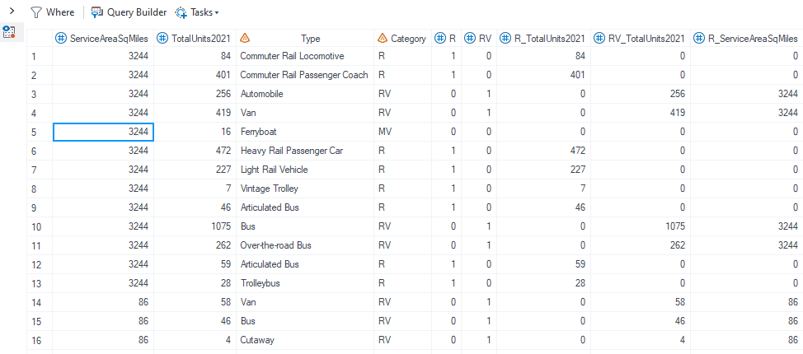
HYPOTHESIS1 - Variables

Slide 7
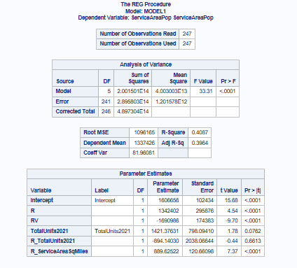
HYPOTHESIS1 - Linear Regression

Slide 8
HYPOTHESIS1 - Explanation of Results
The model is significant overall, which means that the combination of predictors provides a better fit than a model with no predictors.
Both R and RV are significant predictors of the dependent variable, with R having a positive effect and RV having a negative effect.
The variables “TotalUnits2021” may have a relationship with the dependent variable, but the evidence is not strong enough at the 0.05 level.
No strong evidence that the "R_TotalUnits2021" variable has a significant effect on the "ServiceAreaPop".
R_ServiceAreaSqmiles is significant predictor. This indicates that increases in "R_ServiceAreaSqMiles" are associated with increases in the "ServiceAreaPop".

Slide 9

Type Definition
R - Rail and Related Transportation:
Commuter Rail Locomotive, Commuter Rail Passenger Coach, Heavy Rail Passenger Car, Light Rail Vehicle, Vintage Trolley, Articulated Bus, Trolleybus, At-Grade Fixed Guideway Station, Elevated Fixed Guideway Station, Exclusive Platform Station, Underground Fixed Guideway Station
RV - Road Vehicles:
Automobile, Van, Bus, Over-the-road Bus, Cutaway, Minivan
MV - Miscellaneous Vehicles and Facilities:
Ferryboat, Steel Wheel Vehicles, Trucks and other Rubber Tire Vehicles, Other, Administrative & Maintenance, Other, Passenger or Parking
SM - Service and Maintenance Facilities:
Administrative Office / Sales Office, Combined Administrative and Maintenance Facility, General Purpose Maintenance Facility/Depot, Heavy Maintenance & Overhaul (Backshop), Maintenance Facility (Service and Inspection), Vehicle Fueling Facility, Bus Transfer Center
PP - Parking and Passenger Facilities:
Parking Structure, Surface Parking Lot, Ferryboat Terminal, Revenue Collection Facility, Simple At-Grade Platform Station

Slide 10
HYPOTHESES-2
Research Question- What is the impact of Units under performance threshold on Total Units, while considering service area population & Tam tier?
Linear Equation-
Total Units = β0 + β1​(service area population)​+β2​(units underperformance threshold) ​+β3​(Tam Tier) + β4 (Tam Tier x service area population)+ e
Total Units | Dependent Variable
Units under performance threshold | Independent Variable
Service Area population , tam tier & interaction between tam tier & service area population | Control Variables
Note- Data relates to year 2021 only.

Slide 11
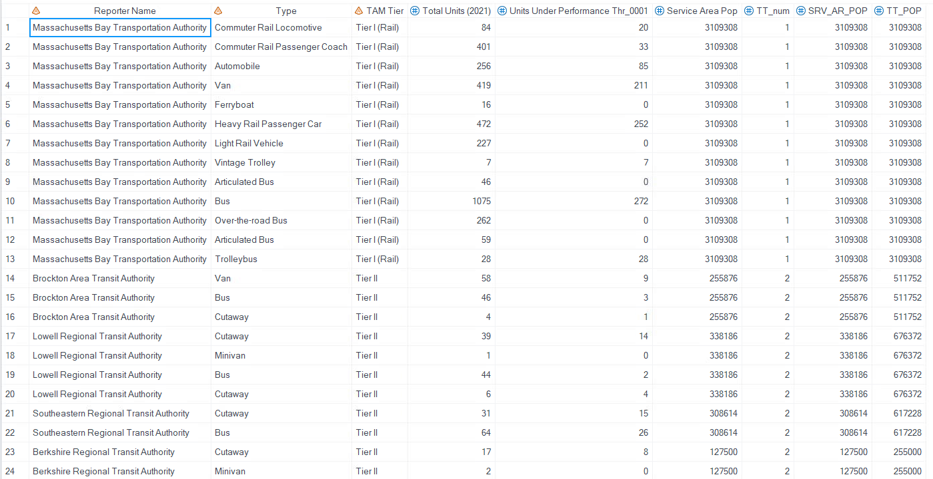
New cleaned dataset for the purpose of Hypotheses-2

Slide 12
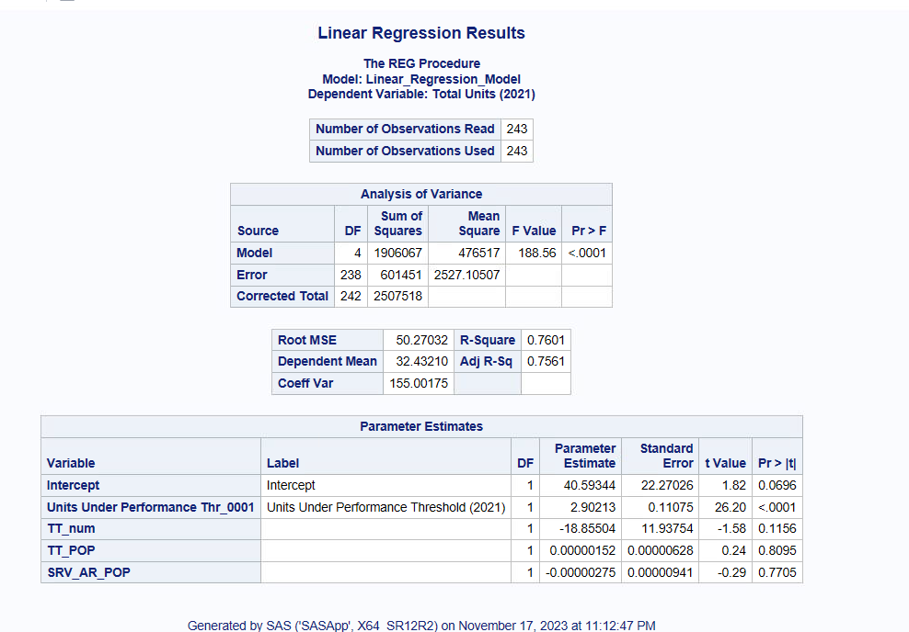
Linear Regression For HYPOTHESES-2

Slide 13
Interpretation of Linear Regression Results-
Adjusted R square of the model is approximately 75% This means that 75% of the variance in the dependent variable is explained by the independent variables in the model, after adjusting for the number of predictors. In other words, the model is a good fit
According to this model the only significant predictor at 99% confidence level is units under performance threshold as its P value is <0.0001. Other predictors in this model are not even significant at 90% confidence level.
This model tells us that total units and units underperformance threshold have a positive relationship which means if there is an increase in units underperformance threshold there will also be an increase in total units.
Units underperformance threshold has a parameter estimate of 3 approximately which means For each one-unit increase in "units underperformance," the model predicts an increase of 3 units in the "total units," Conversely, for each one-unit decrease in "units underperformance," the model predicts a decrease of 3 units in the "total units."
Using this insight each transit agency can efficiently plan their future investment in total units and resolve the problem of over or under resource allocation towards total units.

Slide 14
HYPOTHESIS – 3
Research Question- Does Service area Sq miles have an impact on service area population?
Linear Equation-
Service Area Population =β0+β1×Service Area Sq Miles+β2×total units+β3×(Total Units * Units under performance threshold)+β4x(Units under performance threshold)+ϵ
Note- Data relates to year 2021 only.
Service Area Population | Dependent Variable
Service Area Sq Miles | Independent Variable
Total units, units underperformance, interaction between total units & units under performance | Control Variables

Slide 15
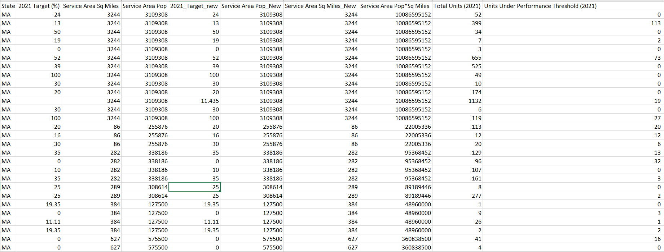
New cleaned dataset for the purpose of Hypotheses-3

Slide 16
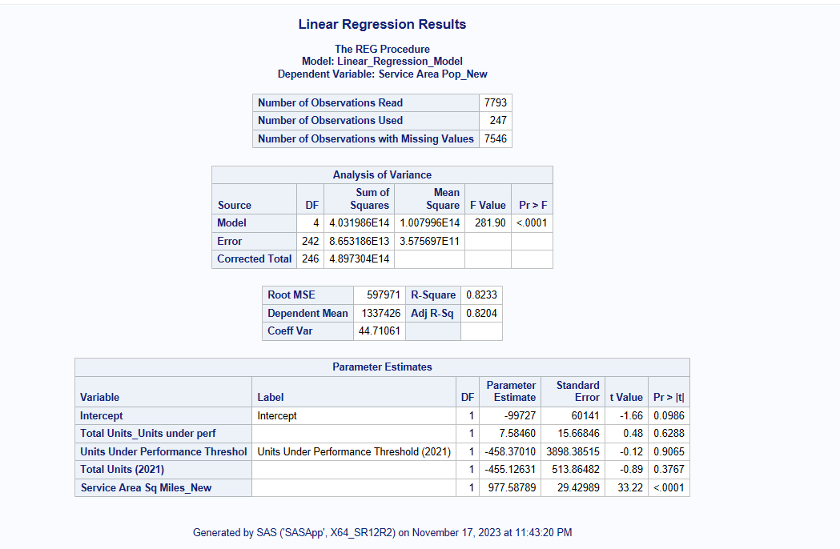
Linear Regression For HYPOTHESES-3

Slide 17
Interpretation of Linear Regression Results-
Adjusted R square of the model is approximately 82% This means that 82% of the variance in the dependent variable is explained by the independent variables in the model, after adjusting for the number of predictors. In other words, the model is a good fit
According to this model the only significant predictor at 99% confidence level is Service area Sq miles as its P value is <0.0001. Other predictors in this model are not even significant at 90% confidence level.
This model tells us that Service Area population and Service Area Sq miles have a positive relationship which means if there is an increase in Service Area Sq miles there will also be an increase in Service Area population.
For each one-unit increase in "service area square miles," the model predicts an increase of 977 units in the "service area population,"Conversely, for each one-unit decrease in "service area square miles," the model predicts a decrease of 977 units in the "service area population,"
This Insight helps the transit agency to understand the advantages of increasing their service area sq miles. As investing funds to increase service area sq miles greatly affects service area population and further revenue of the transit agency.

